Slide 1
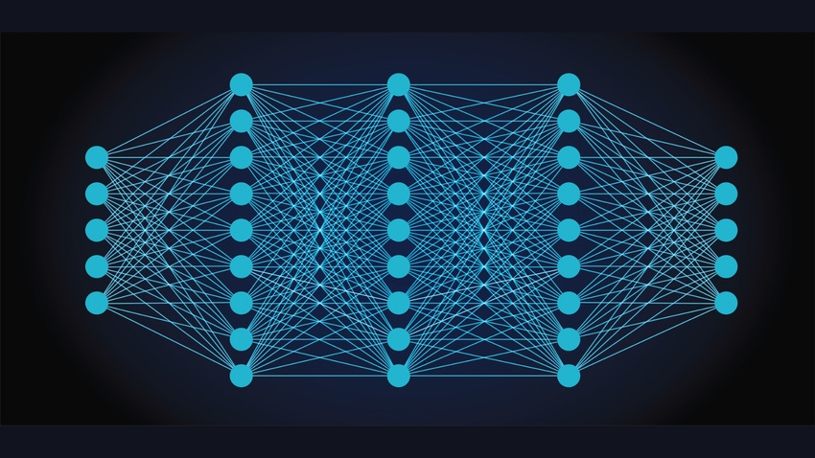
Deep Learning Project
Face Emotion Recognition
Name: Reem Alaa Ali Elardy Id: 2000207

Slide 2
Introduction to Face Emotion Recognition
Face emotion recognition is a cutting-edge technology that enables the detection and interpretation of human emotions through facial expressions.
By analyzing various facial features such as the movement of eyebrows, eyes, and mouth, this technology can accurately determine the emotional state of an individual.
This process involves using advanced algorithms and machine learning models to process and analyze facial data in real-time.

Slide 3
How Detecting and Analyzing facial expression works
Face Detection: The first step in the emotion recognition process is identifying and localizing faces within an image or video frame. Techniques such as the Viola-Jones algorithm, Deep Learning-based detectors, or Multi-task Cascaded Convolutional Networks (MTCNN) are commonly used.
Feature Extraction: After detecting the face, the system extracts key facial features that are indicative of emotions. This is typically done using Convolutional Neural Networks (CNNs), which can learn and extract relevant features such as the shape of the mouth, the position of the eyebrows, and other facial landmarks.
Emotion Classification: The extracted features are then fed into a classification model to determine the emotion. Popular models include deep learning architectures like VGGNet, ResNet, or more specialized networks trained specifically for emotion recognition.

Slide 4
Technologies and Tools
Building an effective face emotion recognition system involves a range of technologies and tools:
Programming Languages: Python is widely used due to its robust libraries and support for machine learning and computer vision.
Libraries and Frameworks: OpenCV for image processing, and deep learning frameworks like TensorFlow, Keras, and PyTorch for building and training models.
Pre-trained Models and Datasets: Leveraging pre-trained models and large annotated datasets (such as FER-2013, CK+, or AffectNet) can accelerate development and improve model accuracy.

Slide 5
Project scope
Data Collection: Gathering datasets from various competitions on Kaggle to maximize the number of classes for face emotion recognition.
Data Augmentation: Increasing the size of the dataset through techniques such as rotation, flipping, and scaling to improve model generalization and robustness.
Transfer Learning: Utilizing pretrained models as a starting point and fine-tuning them by adding or removing layers to adapt them to the specific requirements of face emotion recognition.
Model Comparison: Evaluating the performance of different pretrained models based on accuracy and loss to determine the most suitable model for the project's requirements.

Slide 6







Collected data classes
Angry
Disgust
Fear
Happy
Neutral
Sad
Surprise

Slide 7
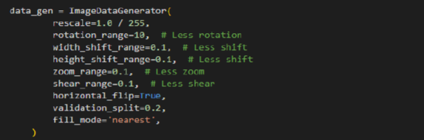
Data augmentation for Training and validation data
Rescale for image: as the input image size is so small and pretrained models only accepts 224*224 image size
Image Augmentation to prevent Overfitting:
Rotation
Width and Height Shifting
Zoom
Shear
Horizontal Flip
Add a split range for the data for Validation

Slide 8
Transfer Learning (Model Creation)
As the training, validation and testing image are gray scale:
Change the image into RGB using Conv2D layer
Next layer will be a pretrained model layers
Add layer that reduces the spatial dimensions to a single vector per feature map.
Add a fully connected layer with L2 regularization and a dropout layer for preventing overfitting.
Add final output layer has num_classes units with SoftMax activation, suitable for a multi-class classification problem.

Slide 9
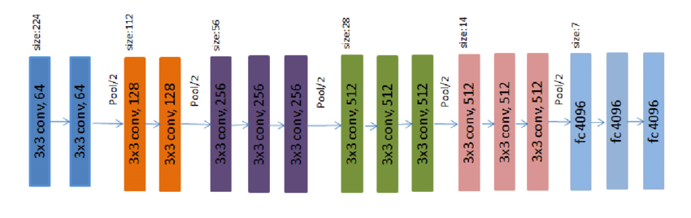
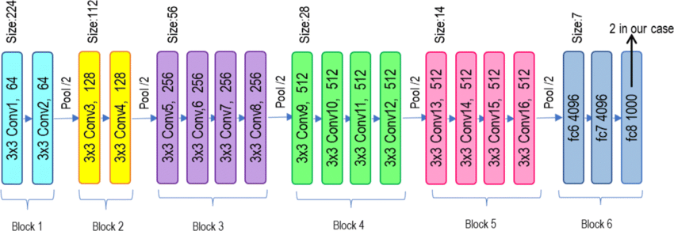
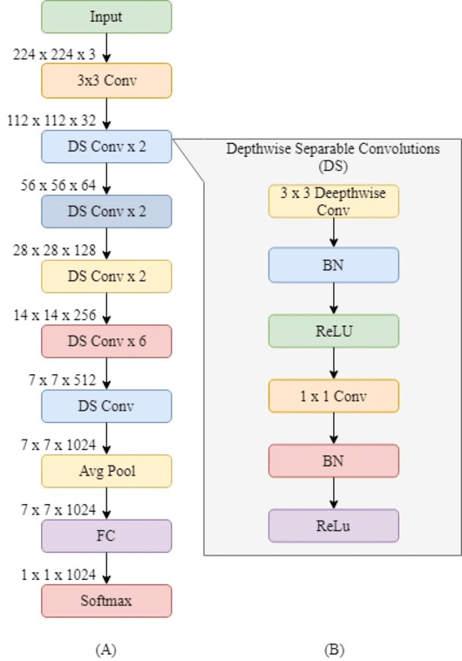
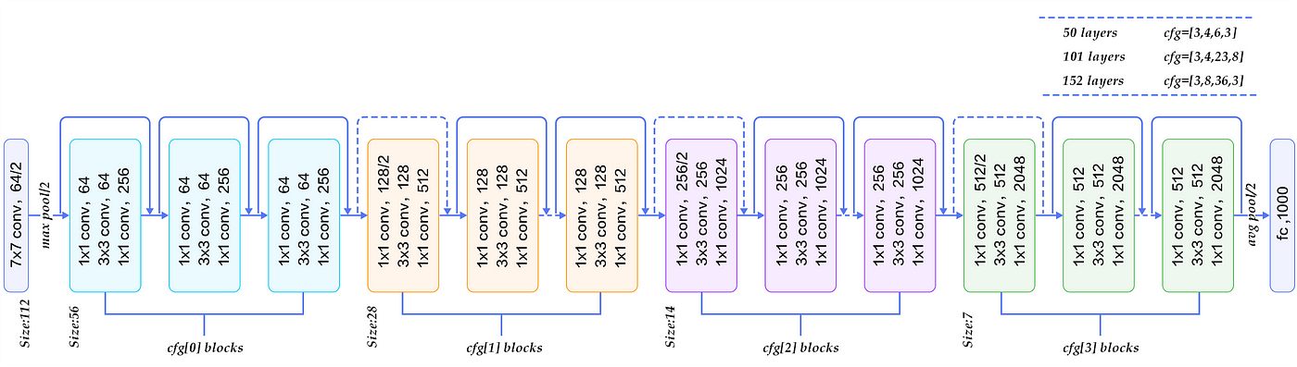
Pretrained Models Used
VGG16
VGG19
ResNet50
MobileNet

Slide 10
Accuracy of each model after training (Comparison)
VGG16
Accuracy: 0.645
Loss: 1.0299
VGG19
Accuracy: 0.635
Loss: 1.0183
ResNet50
Accuracy: 0.68
Loss: 1.094
MobileNet
Accuracy: 0.573
Loss: 1.758

Slide 11
Conclusion
Best Overall Model: ResNet, due to its highest accuracy, making it the most effective for classification tasks on this dataset.
Best Model in Terms of Loss: VGG19, which has the lowest loss, indicating the most confident predictions.
Balanced Performance: VGG16, which offers a good trade-off between accuracy and loss.
Least Effective Model: MobileNet, due to its low accuracy and high loss, suggesting it is not well-suited for this particular dataset.

